Slide 1



BUSINESS PROPOSAL

Slide 2
LEARNING OBJECTIVES
Describe the basic elements of a business proposal.
Discuss the main goals of a business proposal.
Identify effective strategies to use in a business proposal.

Slide 3
BUSINESS PROPOSAL
INTRODUCTION
In order to be successful in business and industry, you should be familiar with the business proposal.
Business proposals are documents designed to make a persuasive appeal to the audience to achieve a defined outcome, often proposing a solution to a problem.

Slide 4
BUSINESS PROPOSAL
COMMON PROPOSAL ELEMENTS
The Ideas
Traditional Categories
Ethos, Pathos, and Logos
Professional

Slide 5

THE IDEA
COMMON PROPOSAL ELEMENTS
Effective business proposals are built around a great idea or solution.
What makes your idea different or unique?
How can you better meet the needs of the company that other vendors?
What makes you so special?

Slide 6
TRADITIONAL CATEGORIES OF PROPOSAL
COMMON PROPOSAL ELEMENTS
Cover Page
Executive Summary
Background
Proposal
Market Analysis
Benefits
Timeline
Marketing Plan
Finance
Conclusion

Slide 7
TRADITIONAL CATEGORIES OF PROPOSAL
COMMON PROPOSAL ELEMENTS
Cover Page | Title page with name, title, date, and specific reference to request for proposal if applicable.
Executive Summary | Like an abstract in a report, this is a one- or two-paragraph summary of the product or service and how it meets the requirements and exceeds expectations.
Background | Discuss the history of your product, service, and/or company and consider focusing on the relationship between you and the potential buyer and/or similar companies.
Proposal | The idea. Who, what, where, when, why, and how. Make it clear and concise. Don’t waste words, and don’t exaggerate. Use clear, well-supported reasoning to demonstrate your product or service.
Market Analysis | What currently exists in the marketplace, including competing products or services, and how does your solution compare?

Slide 8
TRADITIONAL CATEGORIES OF PROPOSAL
COMMON PROPOSAL ELEMENTS
Benefits | How will the potential buyer benefit from the product or service? Be clear, concise, specific, and provide a comprehensive list of immediate, short, and long-term benefits to the company.
Timeline | A clear presentation, often with visual aids, of the process, from start to finish, with specific, dated benchmarks noted.
Marketing Plan | Delivery is often the greatest challenge for Web-based services—how will people learn about you? If you are bidding on a gross lot of food service supplies, this may not apply to you, but if an audience is required for success, you will need a marketing plan.
Finance | What are the initial costs, when can revenue be anticipated, when will there be a return on investment (if applicable)? Again, the proposal may involve a one-time fixed cost, but if the product or service is to be delivered more than once and extended financial plan noting costs across time is required.
Conclusion | Like a speech or essay, restate your main points clearly. Tie them together with a common them and make your proposal memorable.

Slide 9
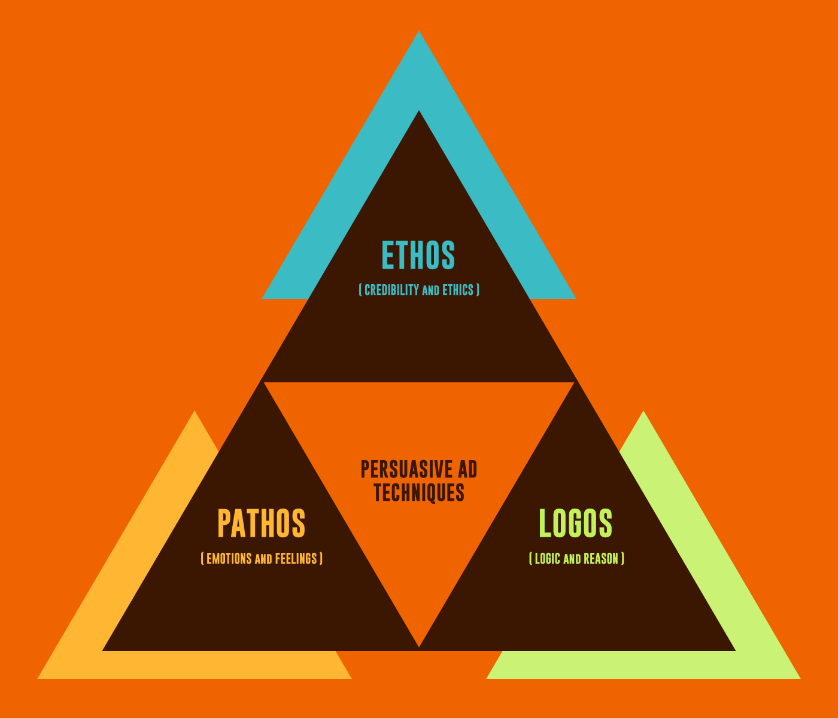
Ethos, Pathos, and Logos
COMMON PROPOSAL ELEMENTS
Ethos refers to credibility
Pathos prefer to passion and enthusiasm
Logos prefer to logic or reason
All three elements are integral parts of your business proposal that require your attention.

Slide 10

Professional
COMMON PROPOSAL ELEMENTS
A professional document is a base requirement. If it is less than professional, you can count on its prompt dismissal.
There should be no errors in spelling or grammar, and all information should be concise, accurate, and clearly referenced when appropriate.

Slide 11

PRACTICE: CHOOSE IDEA FOR "SOCIAL INITIATIVE” PROJECT
Decide on an idea your team will work on, make sure it's a creative, groundbreaking idea.

Slide 12
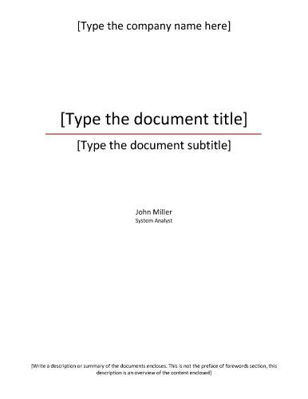
1. COVER PAGE
TRADITIONAL CATEGORIES OF PROPOSAL
Title page with name, title, date, and specific reference to request for proposal if applicable.

Slide 13

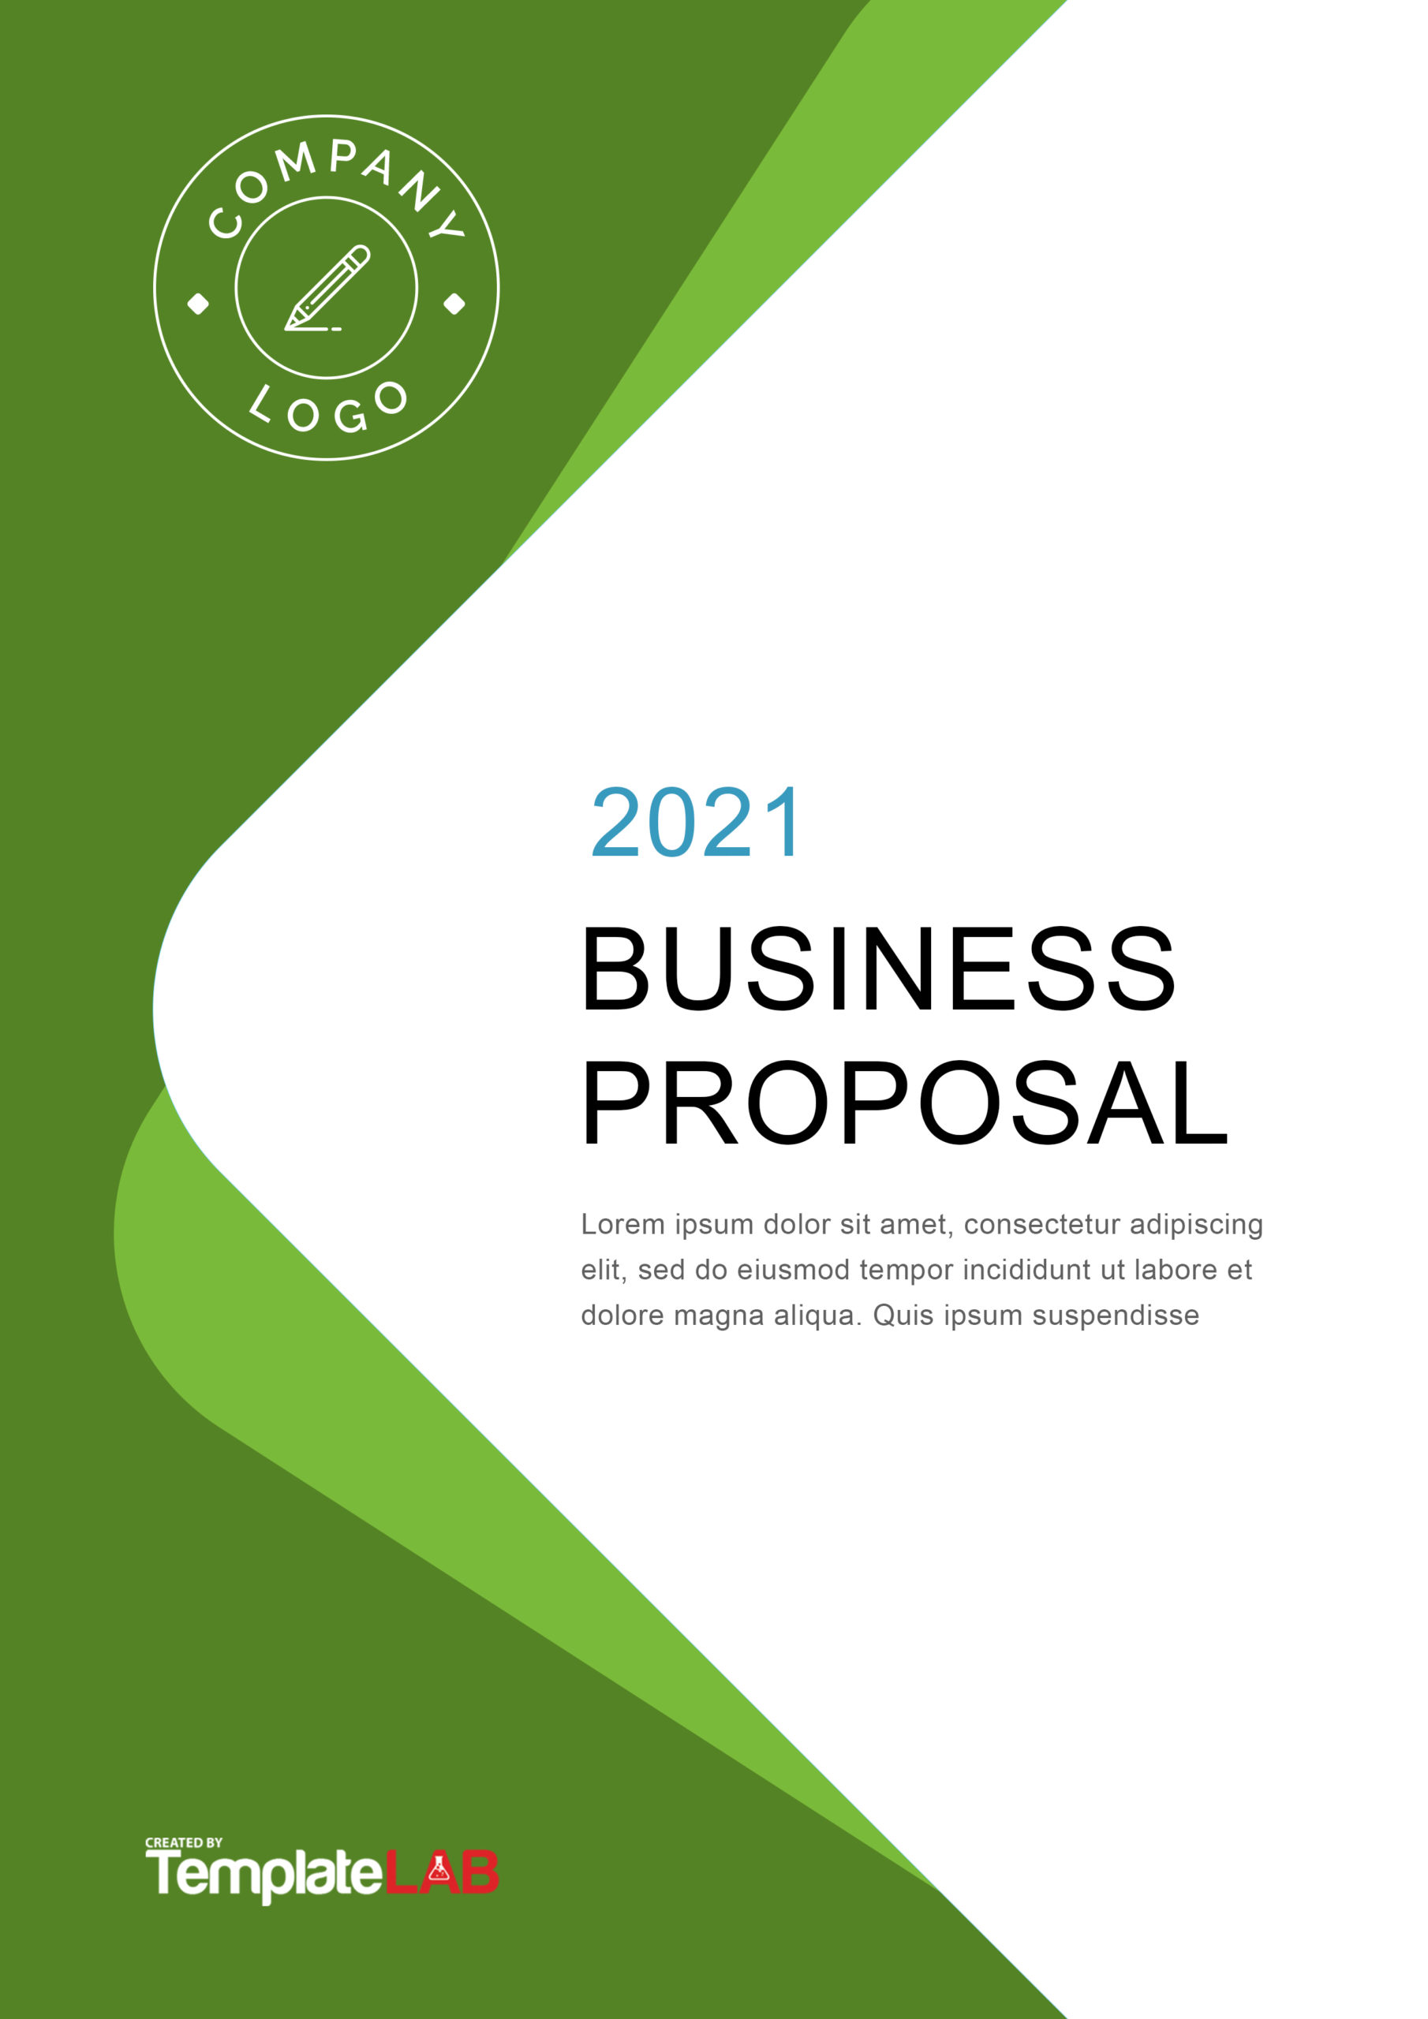

EXAMPLES OF COVER PAGE

Slide 14
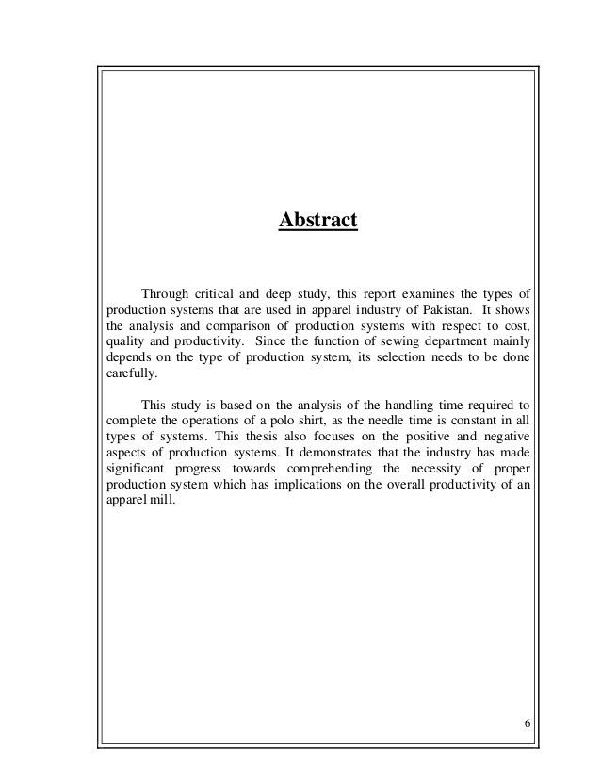
TRADITIONAL CATEGORIES OF PROPOSAL
2. EXECUTIVE SUMMARY
Like an abstract in a report, this is a one- or two-paragraph summary of the product or service and how it meets the requirements and exceeds expectations.

Slide 15
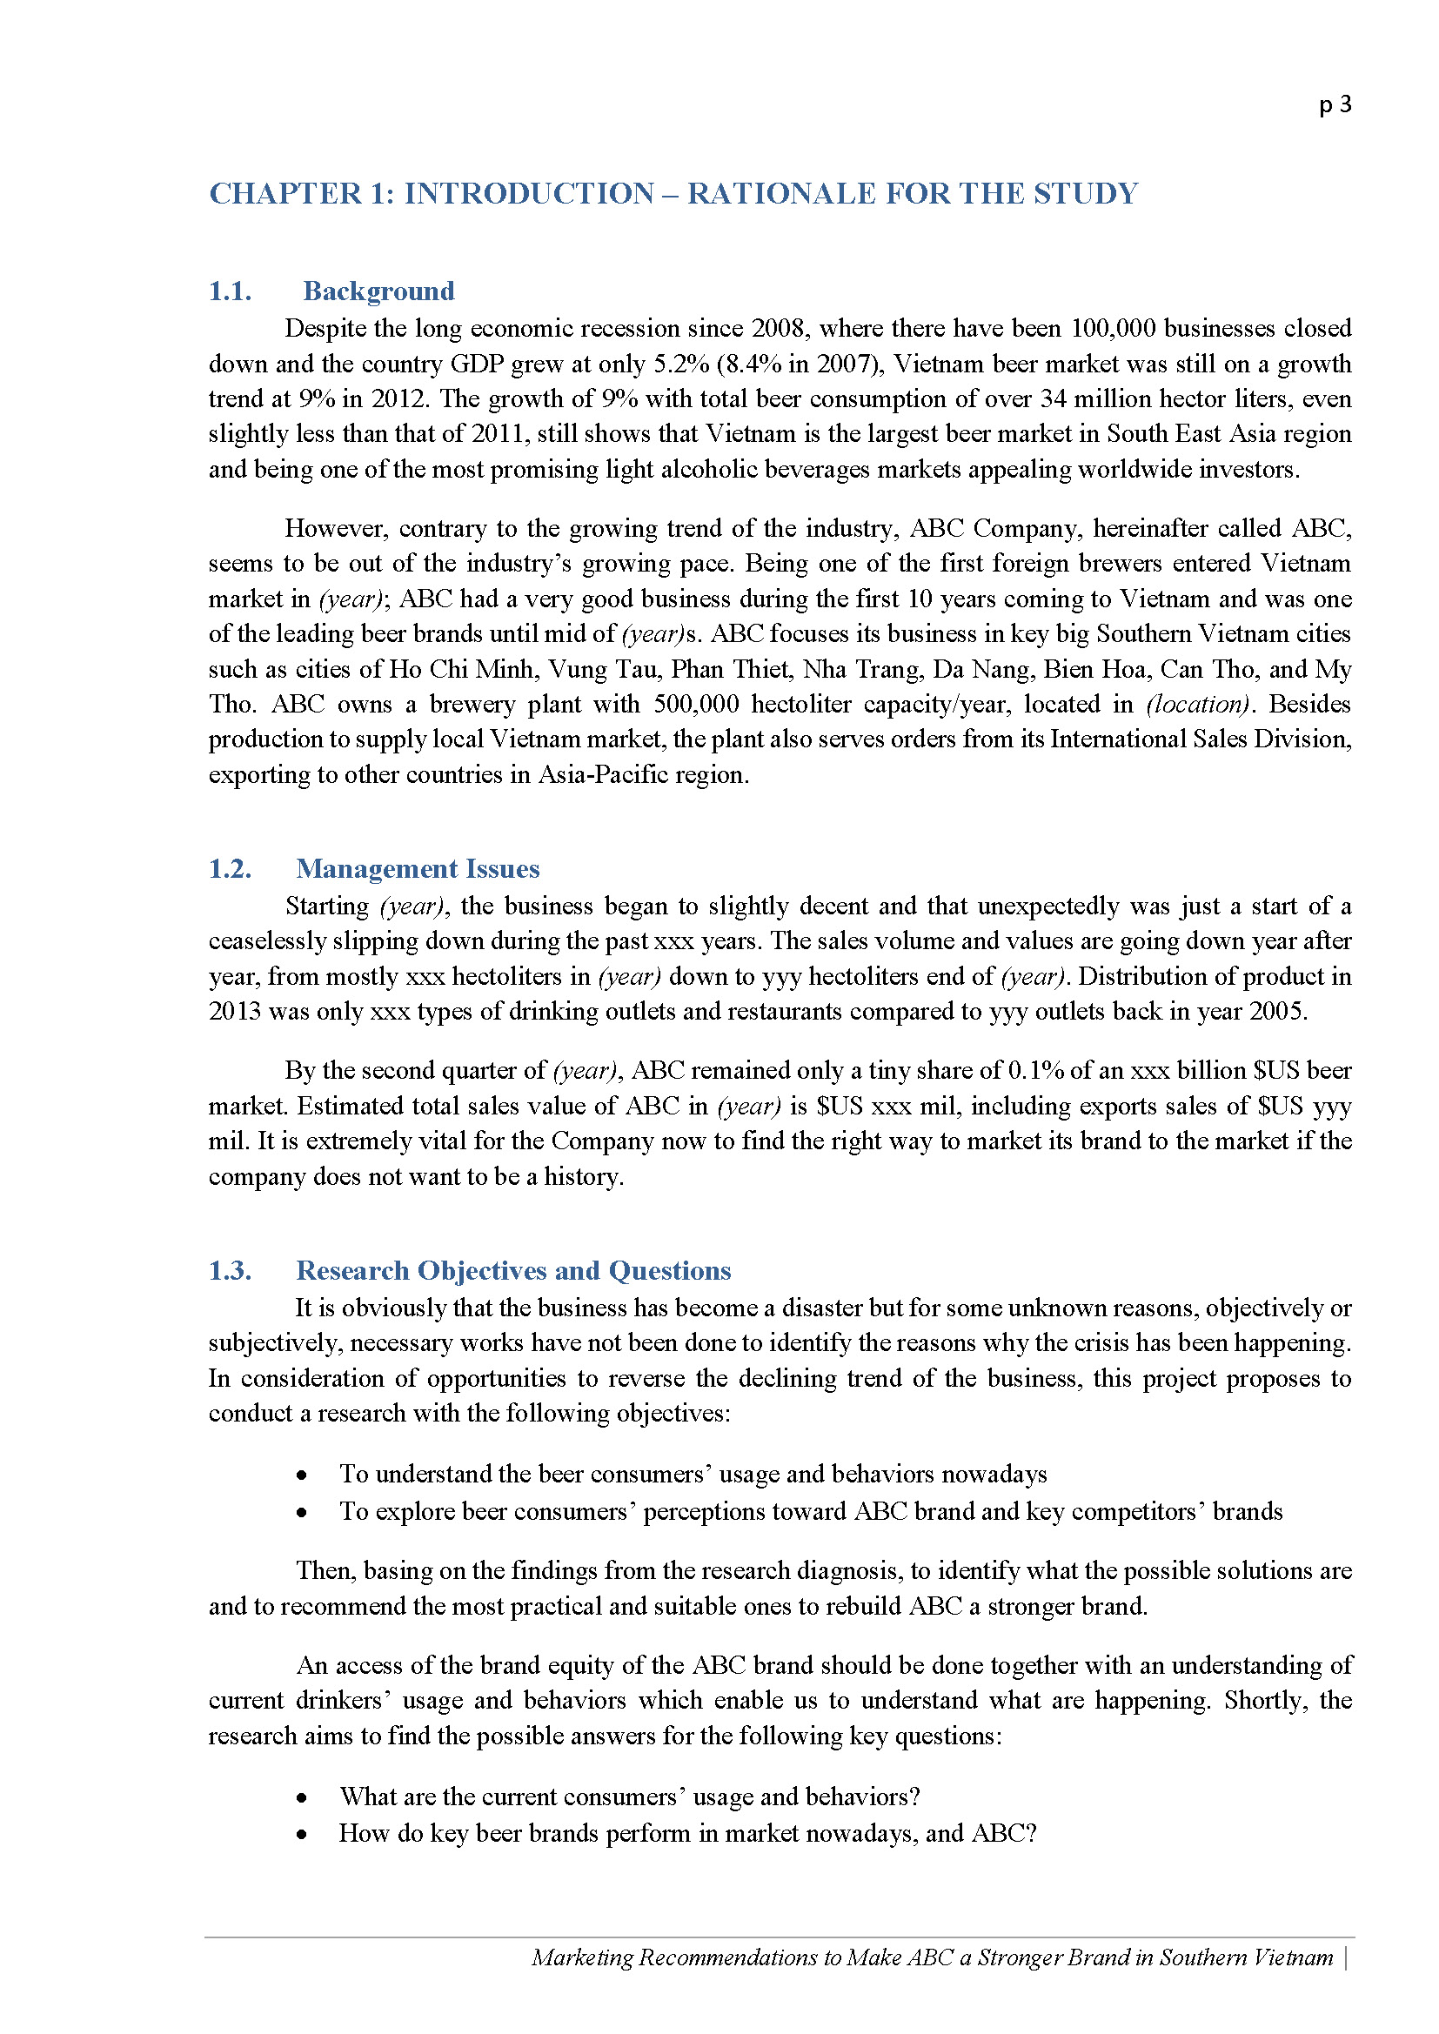
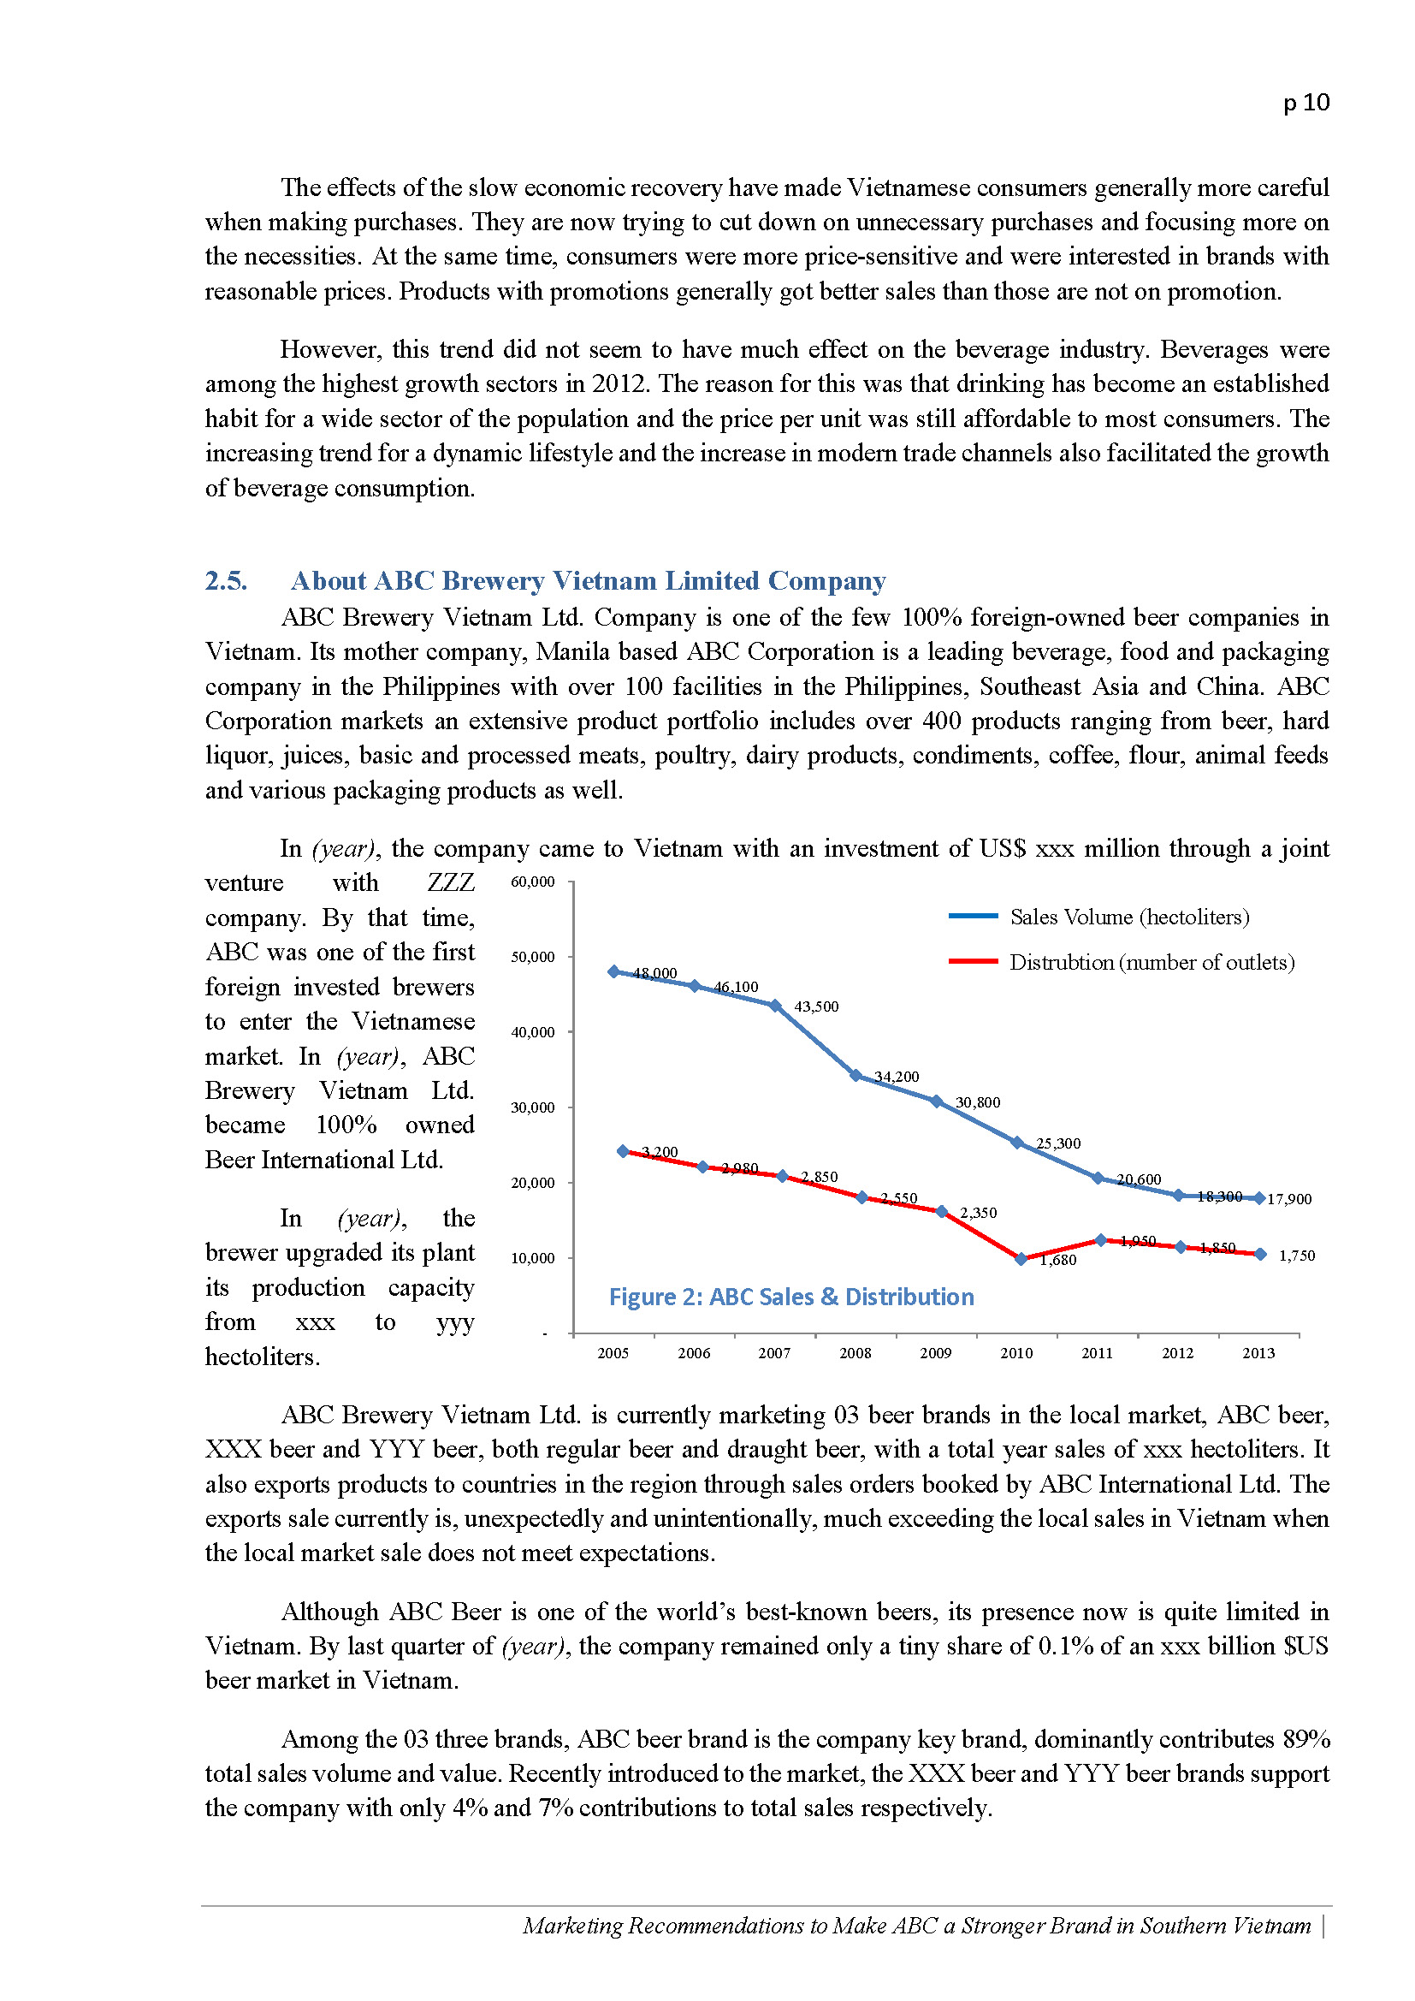
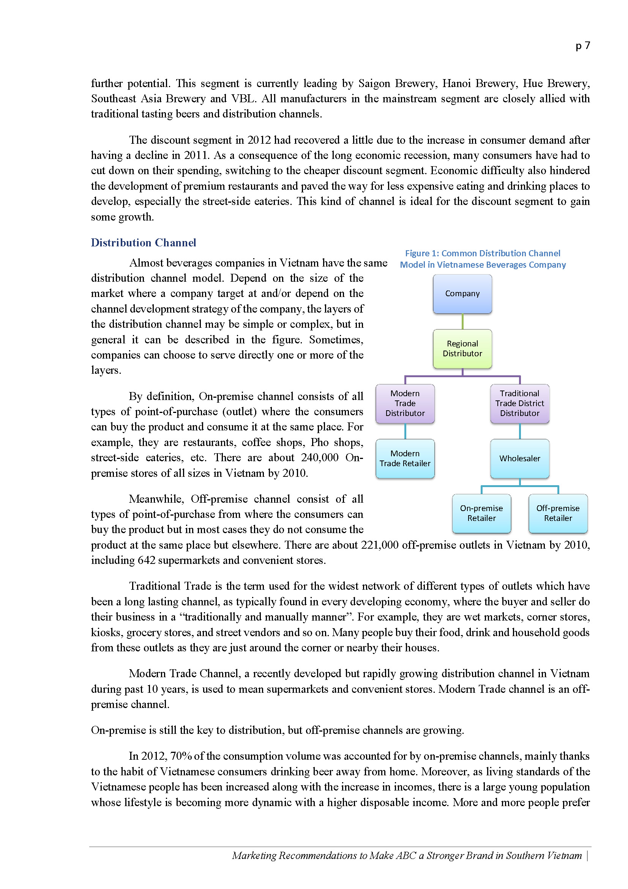
TRADITIONAL CATEGORIES OF PROPOSAL
3. BACKGROUND
Discuss the history of your product, service, and/or company and consider focusing on the relationship between you and the potential buyer and/or similar companies.

Slide 16
4. PROPOSAL
TRADITIONAL CATEGORIES OF PROPOSAL
THE IDEA
Make it clear and concise.
Don’t waste words,
Don’t exaggerate.
Use clear, well-supported reasoning to demonstrate your product or service.
WHO
WHAT
06
01
05
02
WHEN
HOW
04
03
WHY
WHERE

Slide 17
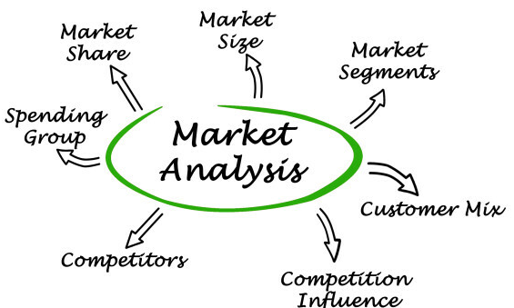
5. MARKET ANALYSIS
TRADITIONAL CATEGORIES OF PROPOSAL
What currently exists in the marketplace, including competing products or services, and how does your solution compare?

Slide 18

6. BENEFITS
TRADITIONAL CATEGORIES OF PROPOSAL
How will the potential buyer benefit from the product or service?
Clear, Concise, Specific, Short
Provide a comprehensive list of immediate and long-term benefits

Slide 19
LET'S START PRACTICING
Small group (5-7 members): Write a proposal from an idea of "Social initiative" project

Slide 20


